Slide 1
Credit Card Fraud Detection Assignment Group 60
Kunal Anilbhai Gupta – 2019HC04744
Vinayak Vaid – 2019HC04745
Khushi Raj – 2019HC04731

Slide 2
Objective
Due to the rise and rapid growth of E-Commerce, use of credit cards for online purchases has dramatically increased.
As credit card becomes the most popular mode of payment for both online as well as regular purchase, cases of fraud associated with it are also rising.
Detecting fraud transactions is of great importance for any credit card company since it is important that credit card companies can recognize fraudulent credit card transactions so that customers are not charged for items that they did not purchase.
The techniques applied here on one such dataset can help classify such fraudulent transactions

Slide 3
Overview of Methodology
Basic understanding of data provided to us namely understanding statistical and visual aspects of the data
Feature engineering and selection techniques pick out important features and normalizing the data to yield accurate results
Creating a model using different classification techniques namely Decision Tree, Naïve Bayes and Logistic Regression and evaluating the metrics to come up with the best model for the given problem

Slide 4
Dataset
The data set has 30 features and one target class indicating 0 – Non Fraudulent, 1 - Fraudulent
The data set has 284807 entries and total size is 67.4 MB.
The data set doesn’t have multiple files.
The data is numerical where most of the features have went through the PCA transformation except ‘Time’ and ‘Amount’.
The data set is highly imbalanced as there are 282493 non-fraudulent transactions and 460 fraudulent transactions. The same can also be viewed visually in the notebook.
The split between training and test data is 75 and 25
There were no missing or null values in the dataset
There were 1081 duplicate records detected which were removed as part of data preprocessing

Slide 5
Feature Engineering

Slide 6
Class Imbalance treatment
Since there are more than 99% of data points belonging to non fraudulent class and only 1% belonging to fraudulent class, the data is highly imbalanced and training our model on original dataset for creating a predictive model would lead to a lot of errors due to overfitting, misclassifying the fraudulent transactions as legitimate activity due to skewed data
To tackle this problem we have applied the following two classic techniques which gave us quite accurate results.
Undersampling majority class
Oversampling minority class using SMOTE (Synthetic Minority Over-sampling) which synthesize data from existing ones by selecting data that are close or similar in the feature space and drawing a line between data and make new data at a point on the line.

Slide 7
Methodology

Slide 8
Classifiers
We used three different classification algorithms to build our model and compared the results using standard evaluation metrics
Decision Tree
Naïve Bayes Classifier
Logistic Regression
We have applied both undersampling and oversampling through SMOTE on all the models built under various classification techniques

Slide 9
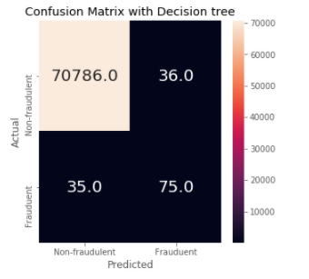
Decision Tree Classifier
Without dealing with class imbalance problem and using the full dataset with 75 and 25 training and test data split to fit the model we got the following results
Accuracy – 99.9%
Precision – 99.9%
Recall – 94.8%
F1-score – 94.8%
We can see that although the accuracy and other metrics are high but since the dataset is imbalanced, where the number of non-fraudulent cases is much more than the number of fraudulent cases, hence the model is more sensitive to detect the majority class than minority class

Slide 10
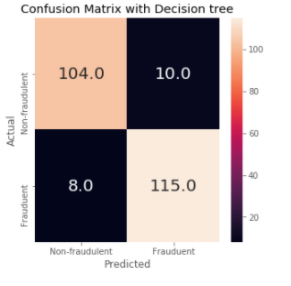
Decision Tree Classifier
Under sampling to randomly select the majority class to balance with minority class
Accuracy – 92.4%
Precision – 92.4%
Recall – 92.4%
F1-score – 92.4%

Slide 11
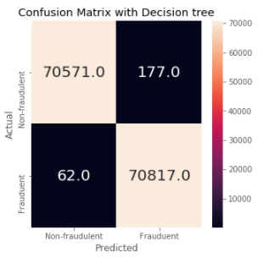
Decision Tree Classifier
Over-sampling is to duplicate data in the minority class using SMOTE which works by selecting data that are close or similar in the feature space and drawing a line between data and make new data at a point on the line
Accuracy – 99.8%
Precision – 99.8%
Recall – 99.8%
F1-score – 99.8%

Slide 12
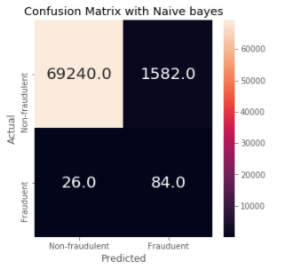
Naïve Bayes Classifier
Without dealing with class imbalance problem and using the full dataset with 75 and 25 training and test data split to fit the model we got the following results
Accuracy – 97.7%
Precision – 99.8%
Recall – 97.7%
F1-score – 98.87%
We can see that although the accuracy and other metrics are high but since the dataset is imbalanced, where the number of non-fraudulent cases is much more than the number of fraudulent cases, hence the model is more sensitive to detect the majority class than minority class

Slide 13
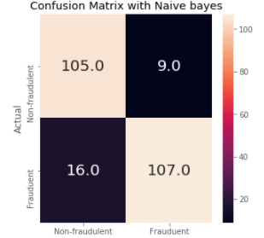
Naïve Bayes Classifier
Under sampling to randomly select the majority class to balance with minority class
Accuracy – 89.5%
Precision – 89.6%
Recall – 89.5%
F1-score – 89.5%

Slide 14
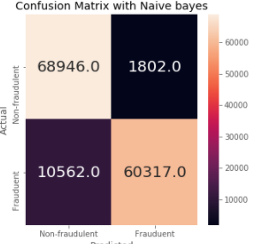
Naïve Bayes Classifier
Over-sampling is to duplicate data in the minority class using SMOTE which works by selecting data that are close or similar in the feature space and drawing a line between data and make new data at a point on the line
Accuracy – 91.3%
Precision – 91.9%
Recall – 91.3%
F1-score – 91.2%

Slide 15
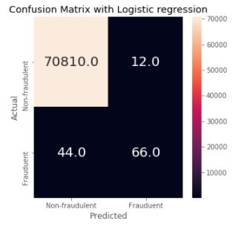
Logistic Regression Classifier
Without dealing with class imbalance problem and using the full dataset with 75 and 25 training and test data split to fit the model we got the following results
Accuracy – 99.9%
Precision – 99.9%
Recall – 99.9%
F1-score – 99.9%
We can see that although the accuracy and other metrics are high but since the dataset is imbalanced, where the number of non-fraudulent cases is much more than the number of fraudulent cases, hence the model is more sensitive to detect the majority class than minority class

Slide 16
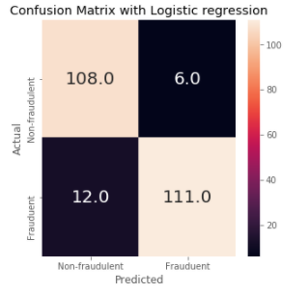
Logistic Regression Classifier
Under sampling to randomly select the majority class to balance with minority class
Accuracy – 92.4%
Precision – 92.5%
Recall – 92.4%
F1-score – 92.4%

Slide 17
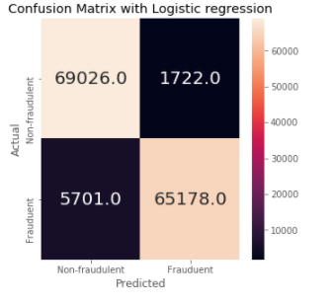
Logistic Regression Classifier
Over-sampling is to duplicate data in the minority class using SMOTE which works by selecting data that are close or similar in the feature space and drawing a line between data and make new data at a point on the line
Accuracy – 94.8%
Precision – 94.9%
Recall – 94.8%
F1-score – 94.8%

Slide 18
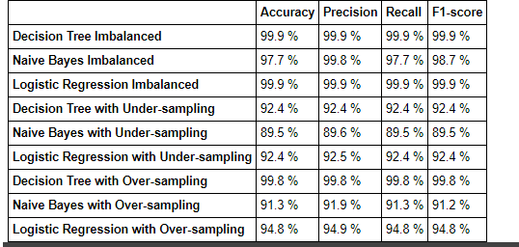
Evaluation Metric

Slide 19
Conclusion
Based on the evaluation metrics we captured during the model building exercise with imbalanced and balanced data in multiple iterations, we conclude that the decision tree classifier model with oversampled data using SMOTE gives us the most accurate results on test data and is the best fit to for detecting fraudulent transactions

Slide 20

Thank You

